Slide 1
Upaji Website flow
This presentation shall guide and explain the process flow of the Upaji web application

Slide 2
Upaji Homepage when user is not signed in with dropdown for Settings icon

Slide 3
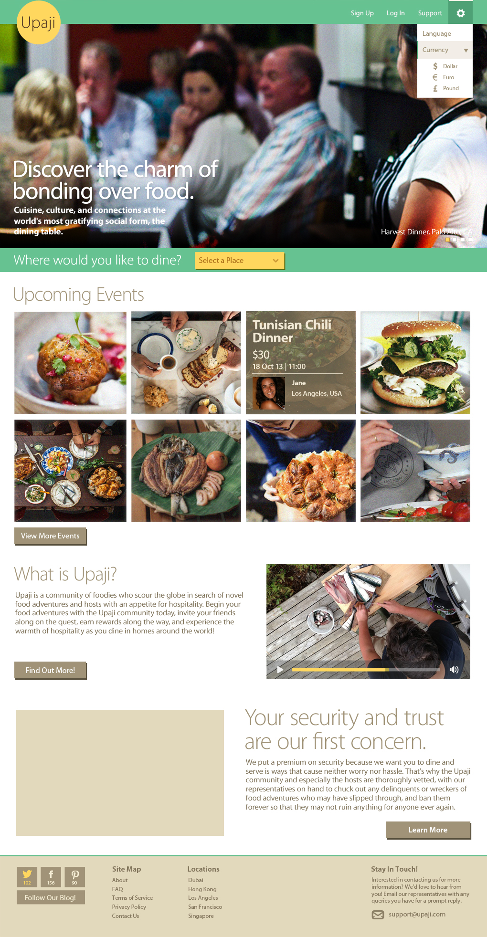

Slide 4
Upaji Homepage when user is not signed in with dropdown for Support icon

Slide 5
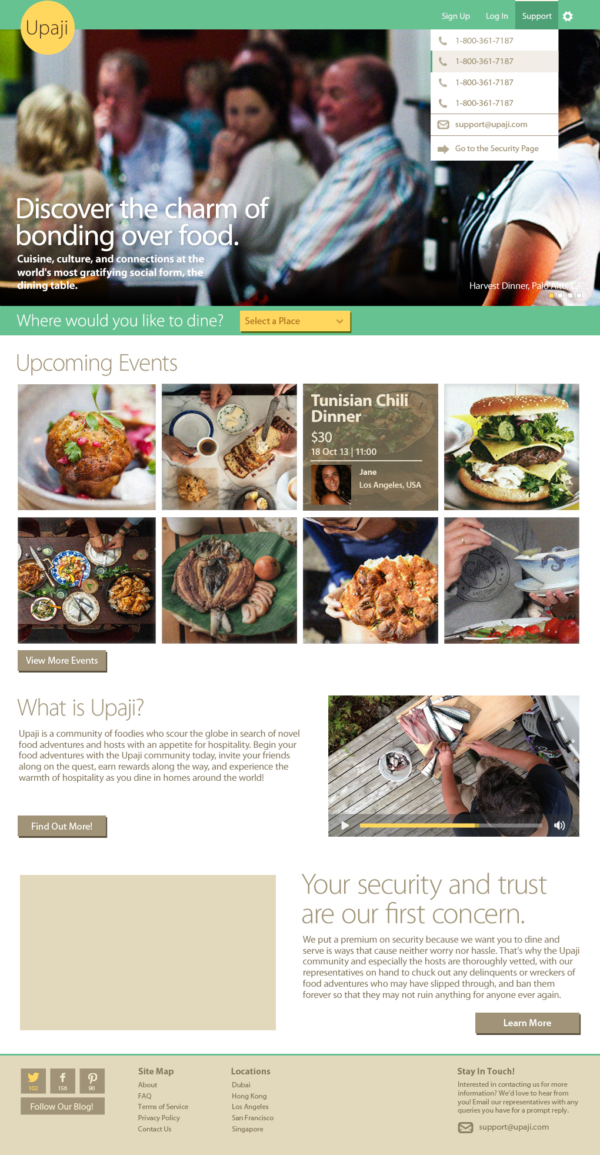

Slide 6
Upon clicking on Login link from the top navigation bar, a popup will appear asking users to either Login through their Facebook account, Google account or their registered Upaji account.

Slide 7
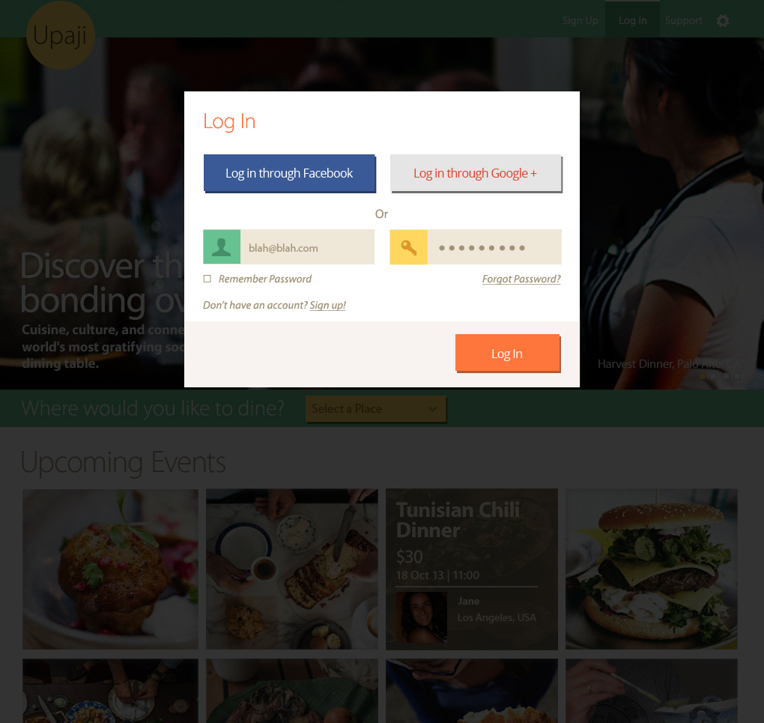

Slide 8
Upaji Homepage when user is signed in with dropdown for Profile icon

Slide 9
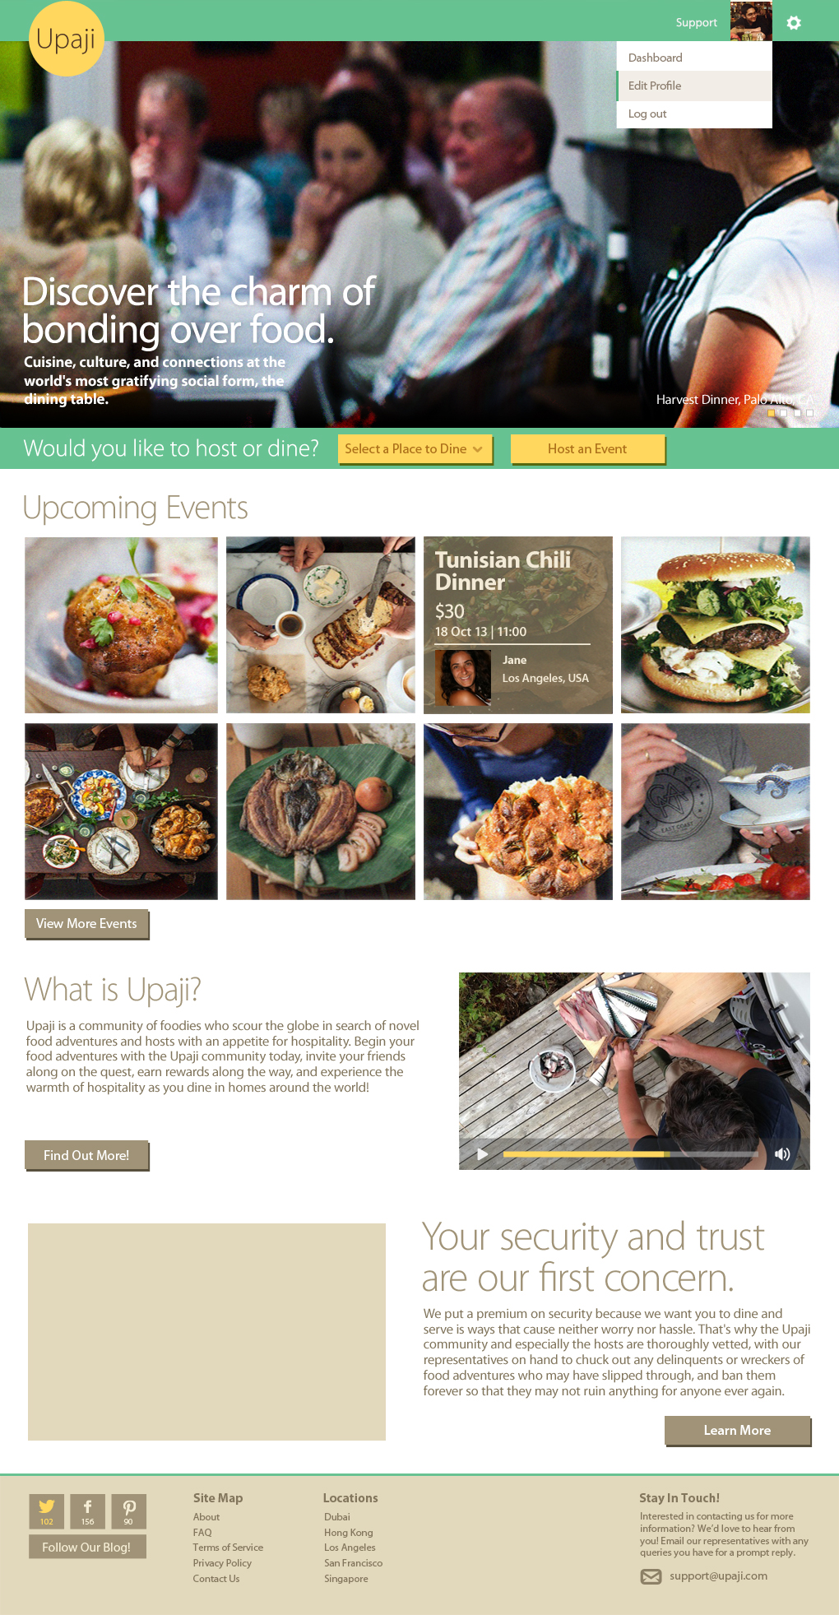

Slide 10
On Selecting the City from the destination drop down, the website will take you to the events hosted in that particular destination.

Slide 11
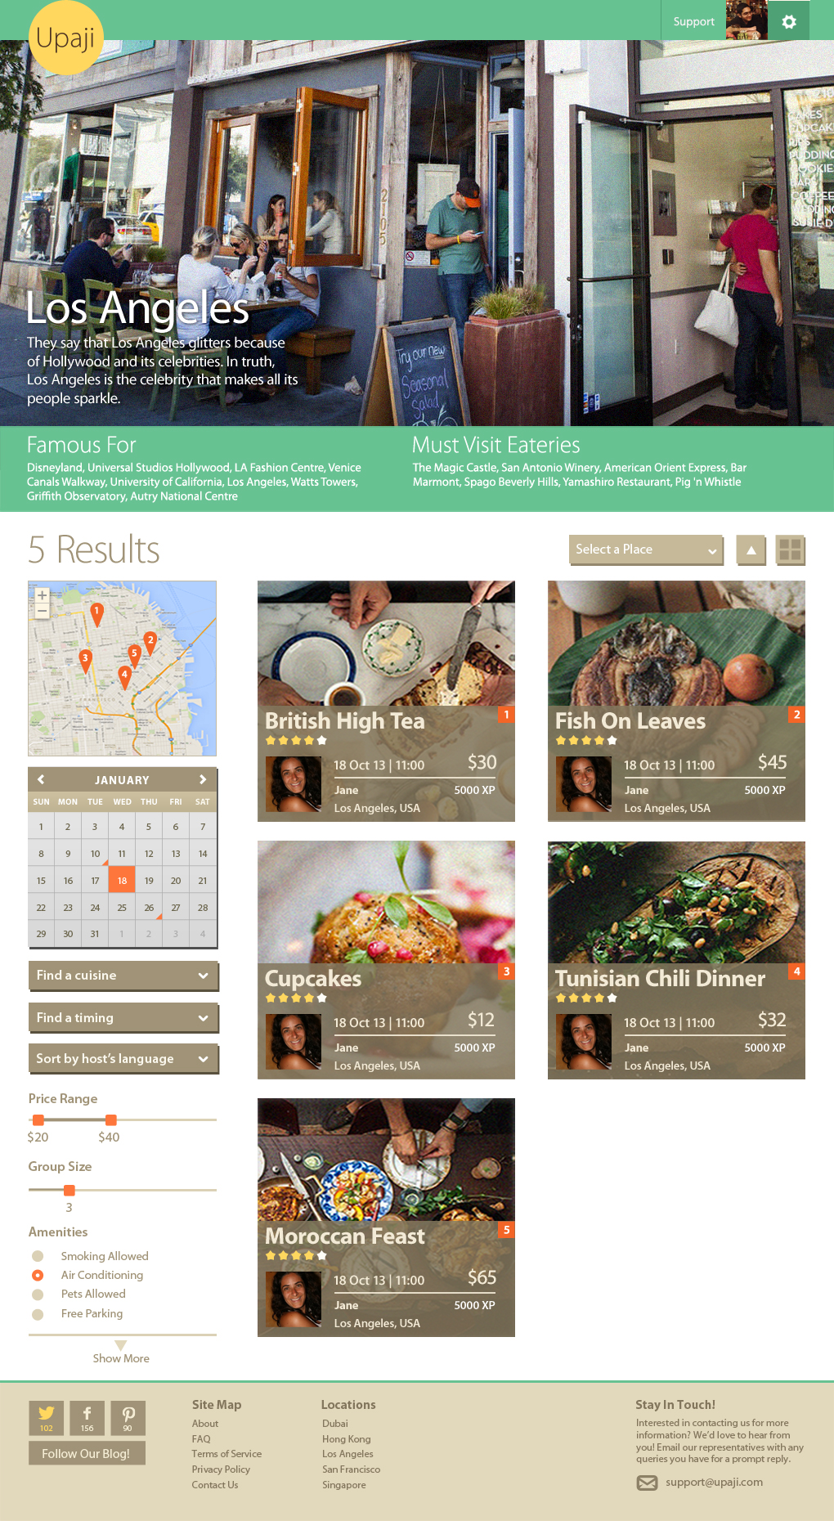

Slide 12
Upon clicking on any event image, the website will take you to the event detail page.

Slide 13
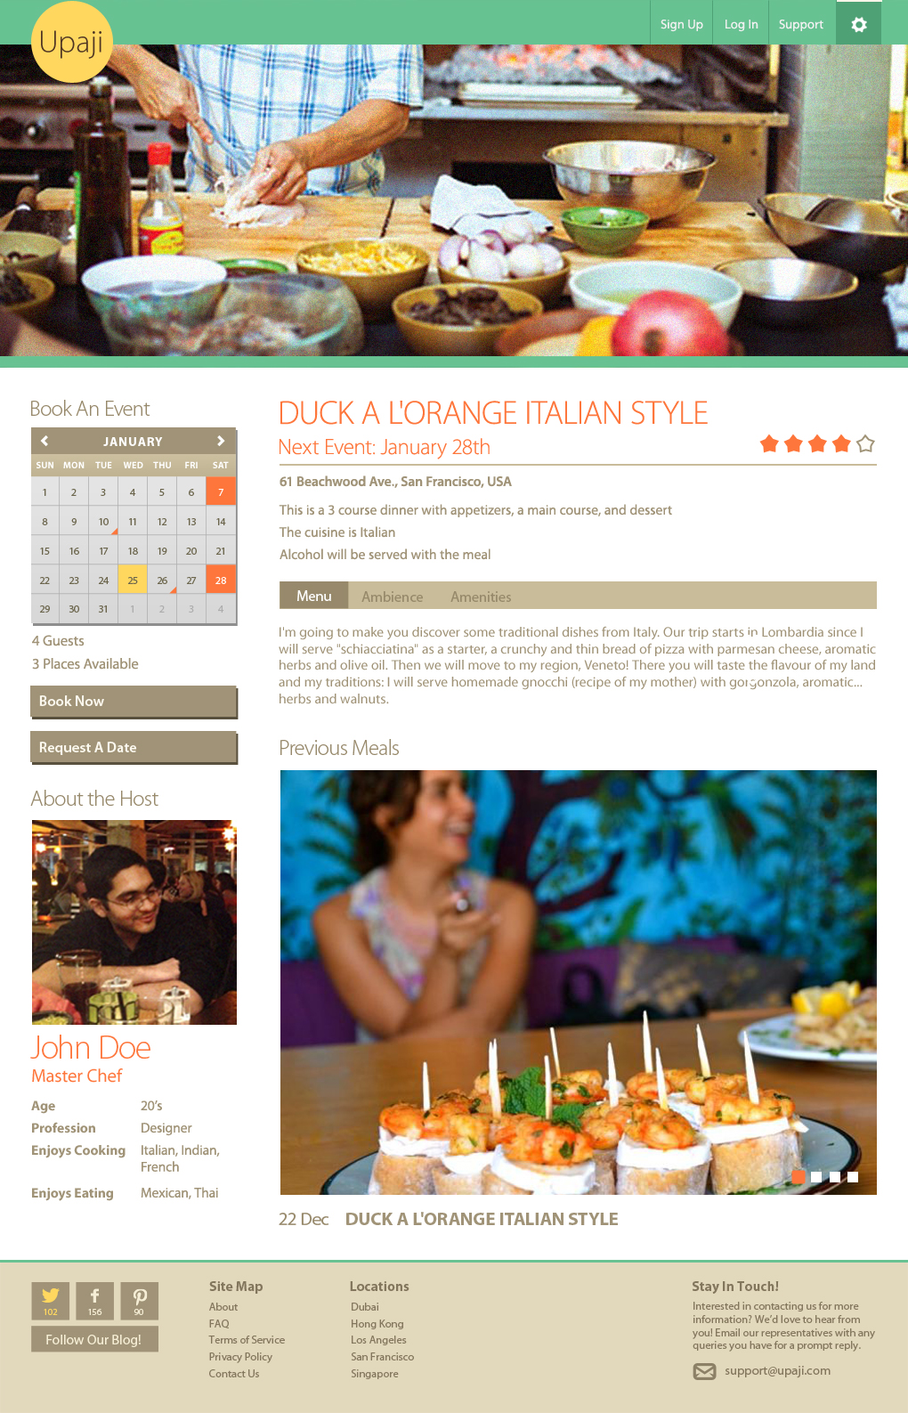

Slide 14
Upon clicking on Request a date button, a popup will appear with the option to select date.

Slide 15
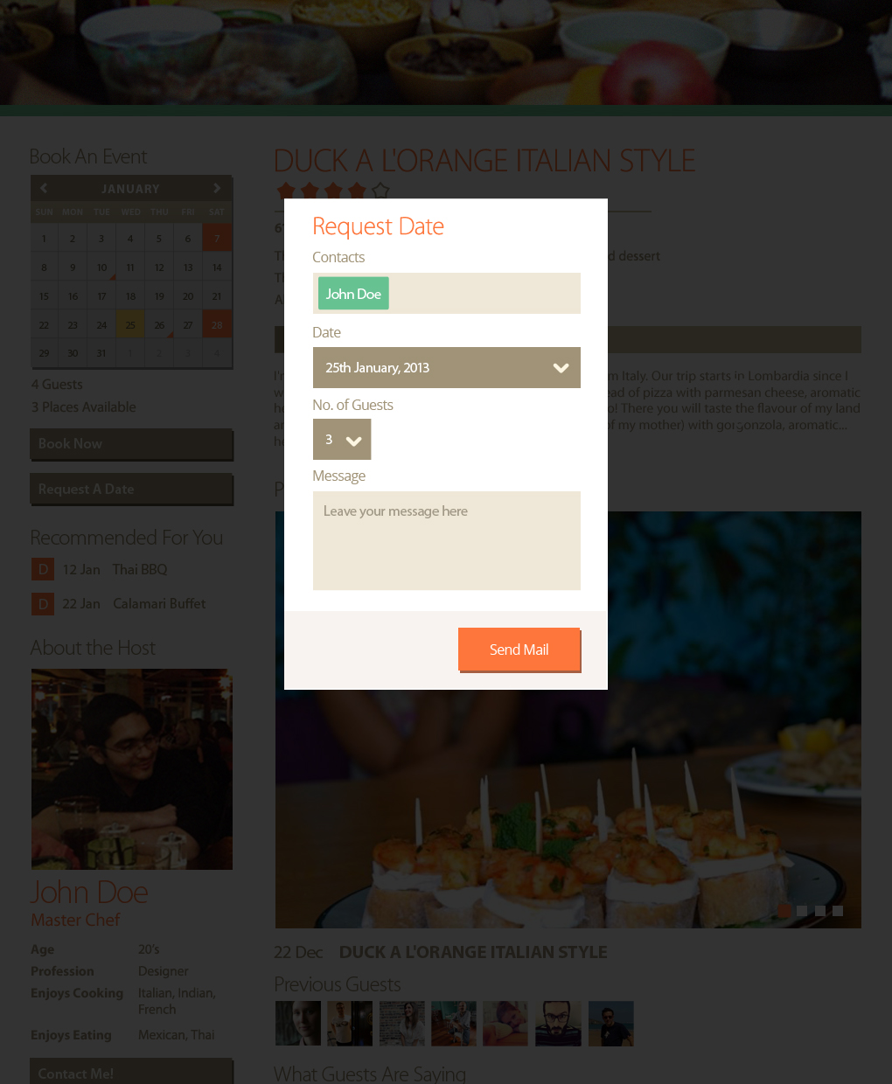

Slide 16
Upon clicking on Request a date button, if the user is not signed in, a popup will appear with the option to login or sign up.

Slide 17
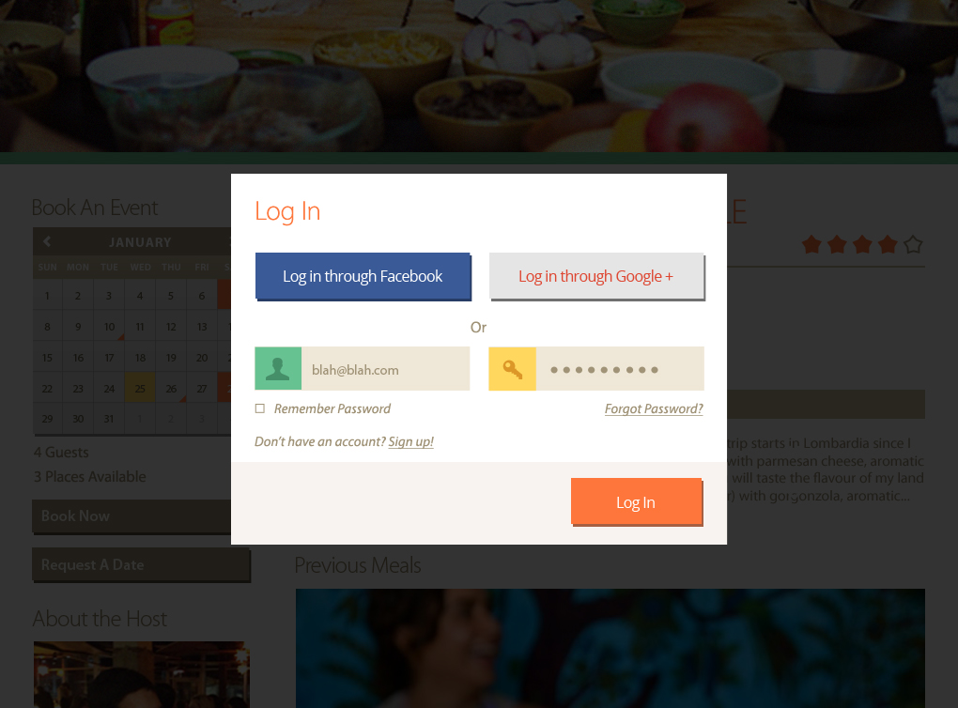

Slide 18
Users can also sign up from the previous screen, by clicking on the sign up link. Sign up link will open a new popup from where the users can sign up instantly.

Slide 19
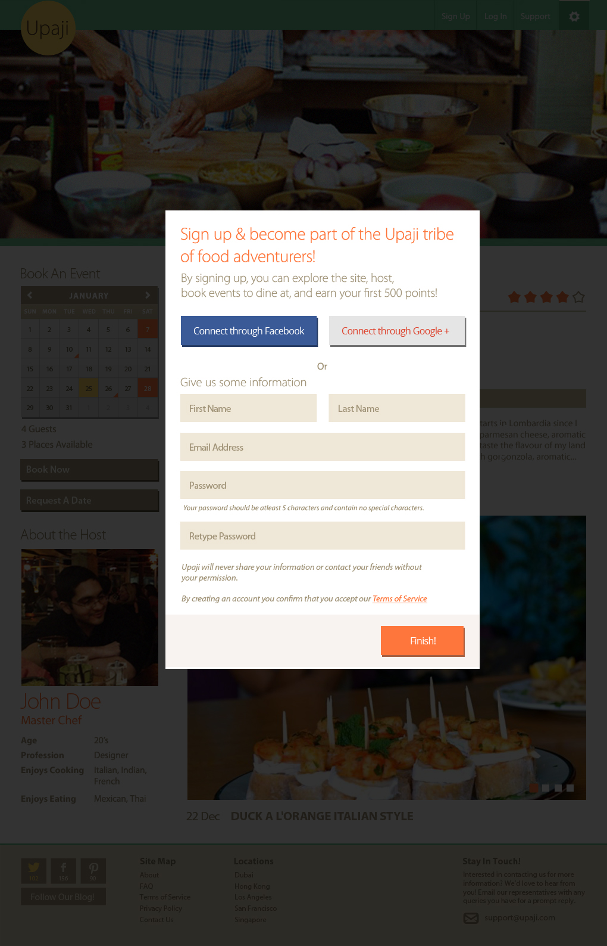

Slide 20
Once the users sign up from the popup, they will be encouraged to create and complete their profile so they can avail the benefits Upaji has to offer.

Slide 21
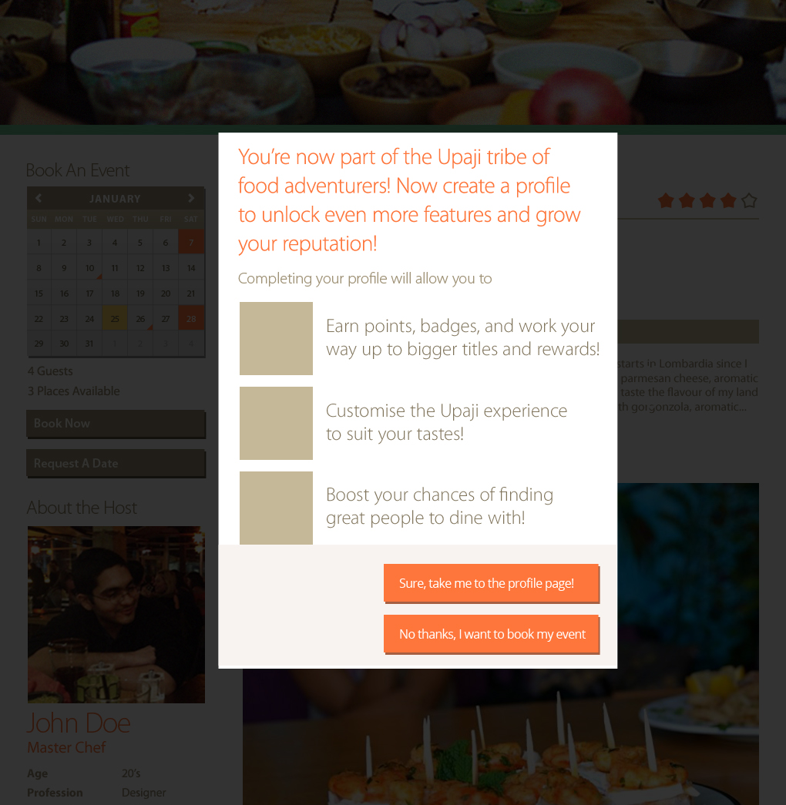

Slide 22
If user clicks on the profile creation link, they will be taken to the page where they can fill in their profile details.

Slide 23
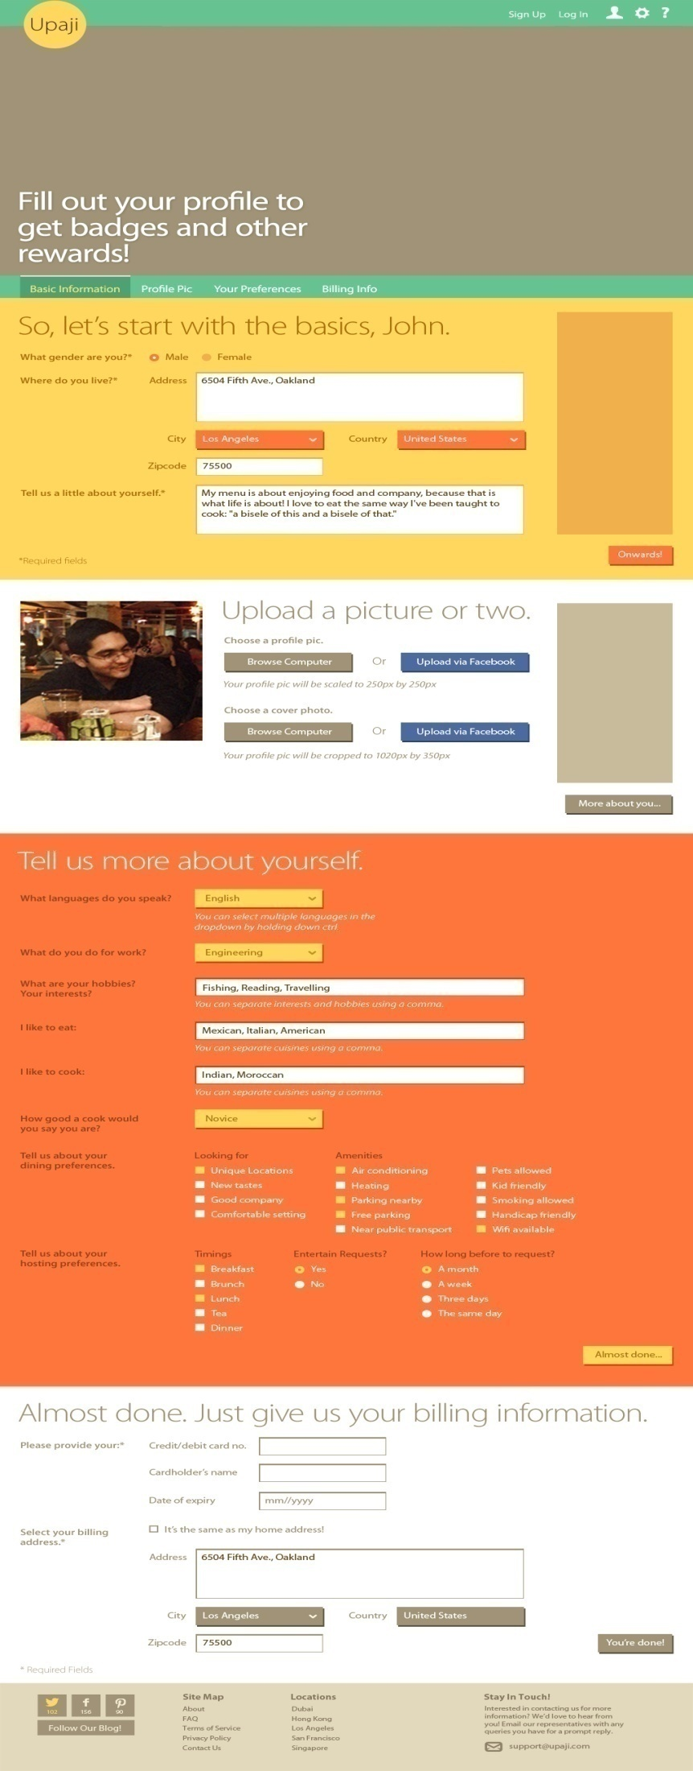

Slide 24
If the user is signed up/logged in, the Event details page will appear with all the details. (Notice that the reviews and previous guests information appear visible for registered users only.)

Slide 25
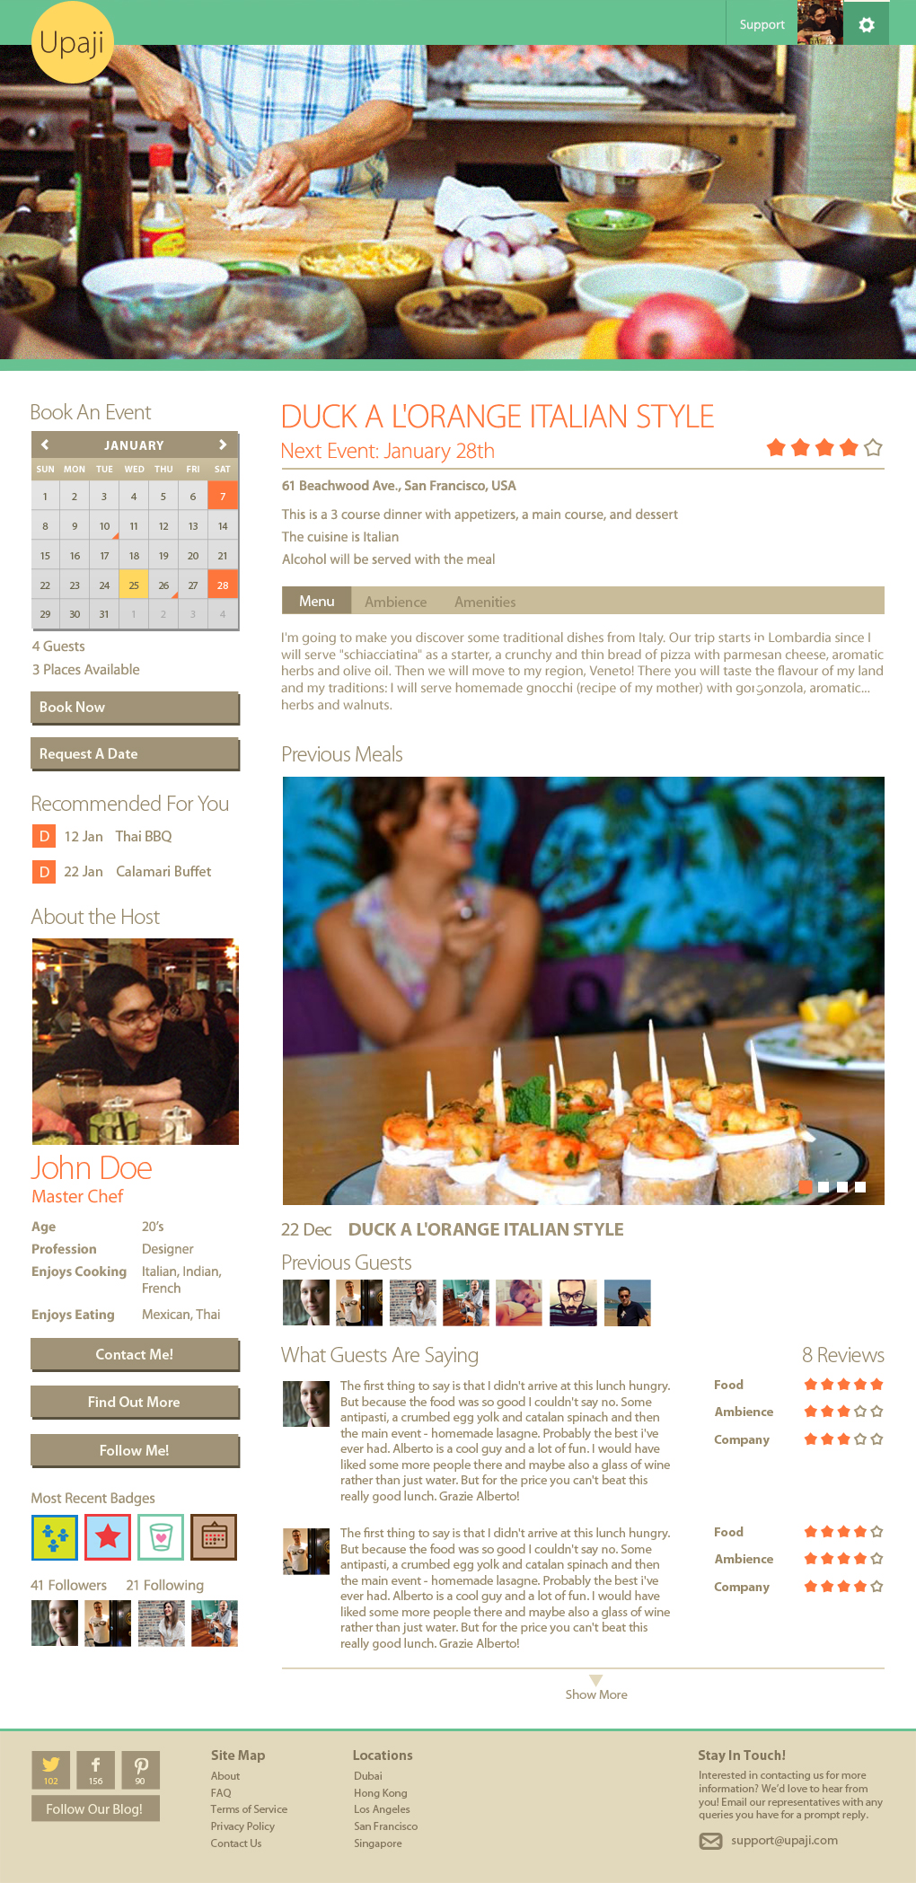

Slide 26
From the Homepage, upon clicking on ‘Find out More’ button, under What is Upaji, the user will be taken to the About page.

Slide 27
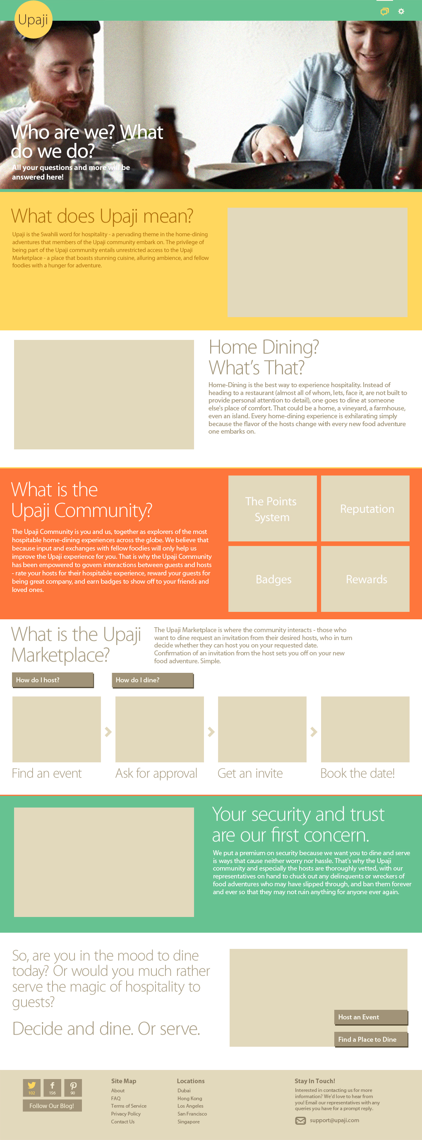

Slide 28
Once the user is logged in, he/she can go to their dashboard with all the functionalities available.

Slide 29
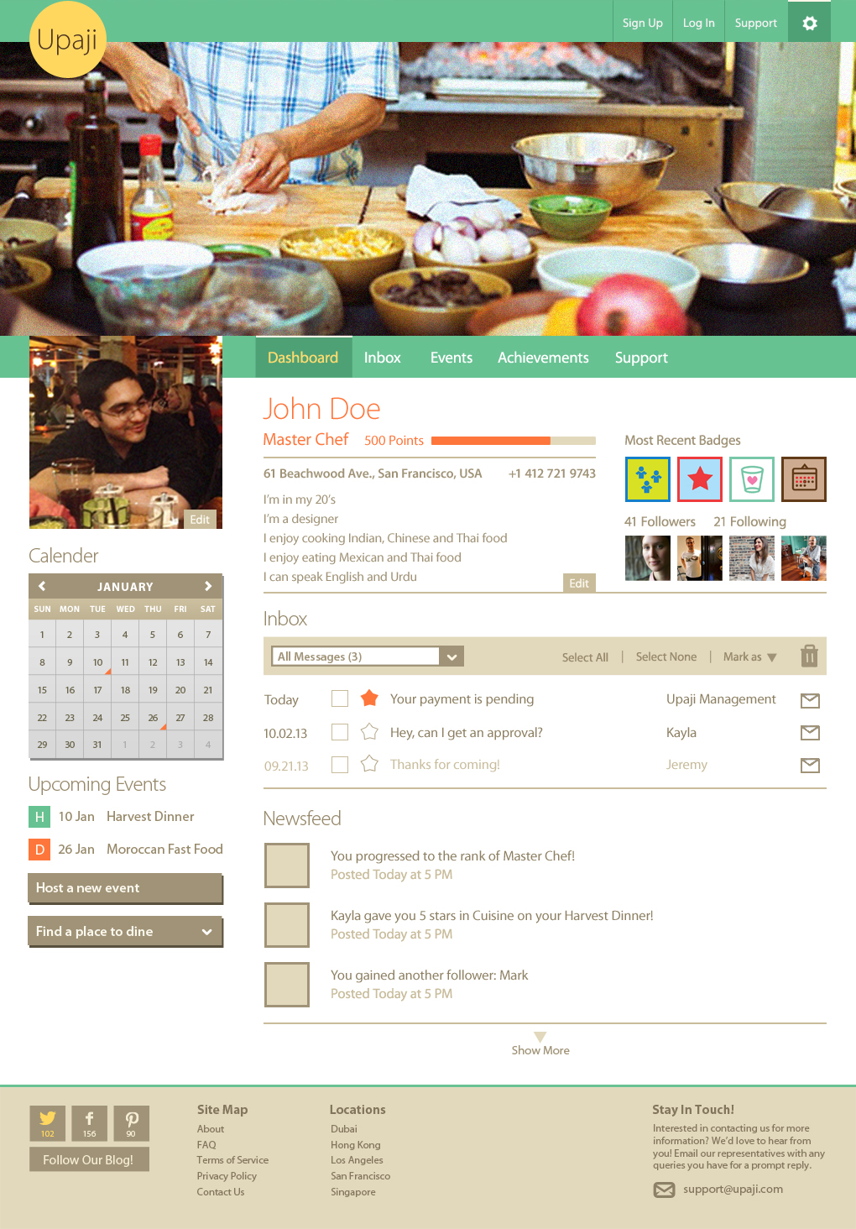

Slide 30
If the User clicks on the Inbox tab from the sub navigation bar of the Dashboard, they will be taken to their Upaji inbox.

Slide 31
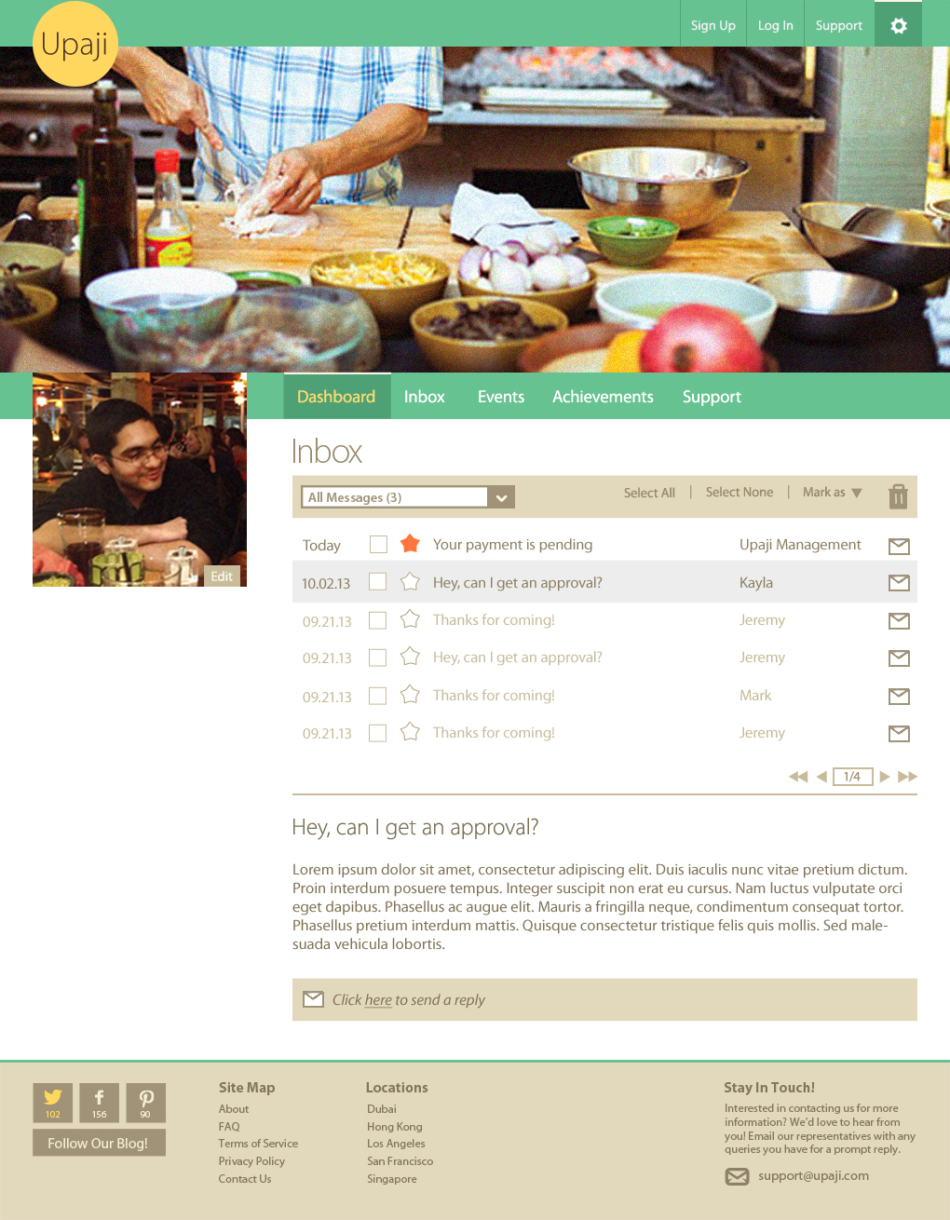

Slide 32
If the User clicks on the Events tab from the sub navigation bar of the Dashboard, they will be taken to their Upaji Events section.

Slide 33
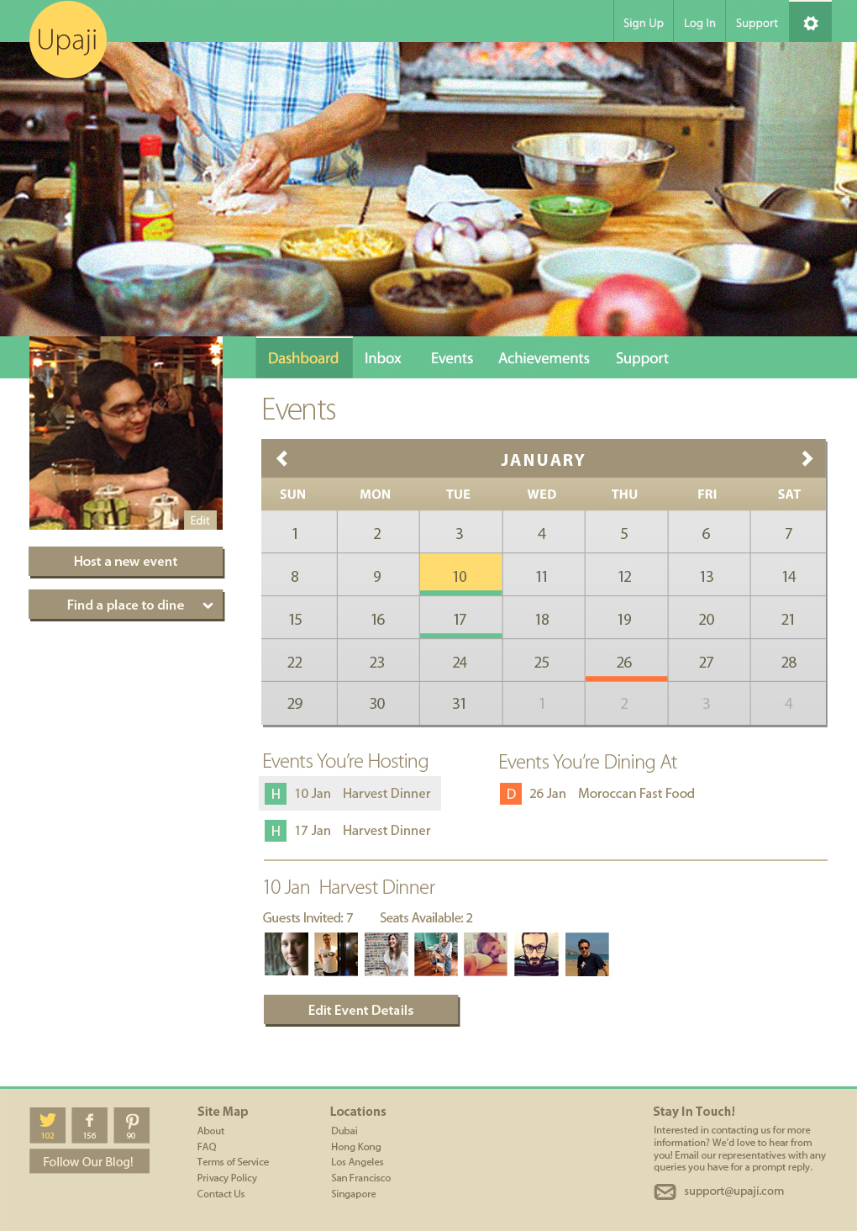

Slide 34
If the User clicks on the Achievements tab from the sub navigation bar of the Dashboard, they will be taken to their Upaji Achievements section.

Slide 35
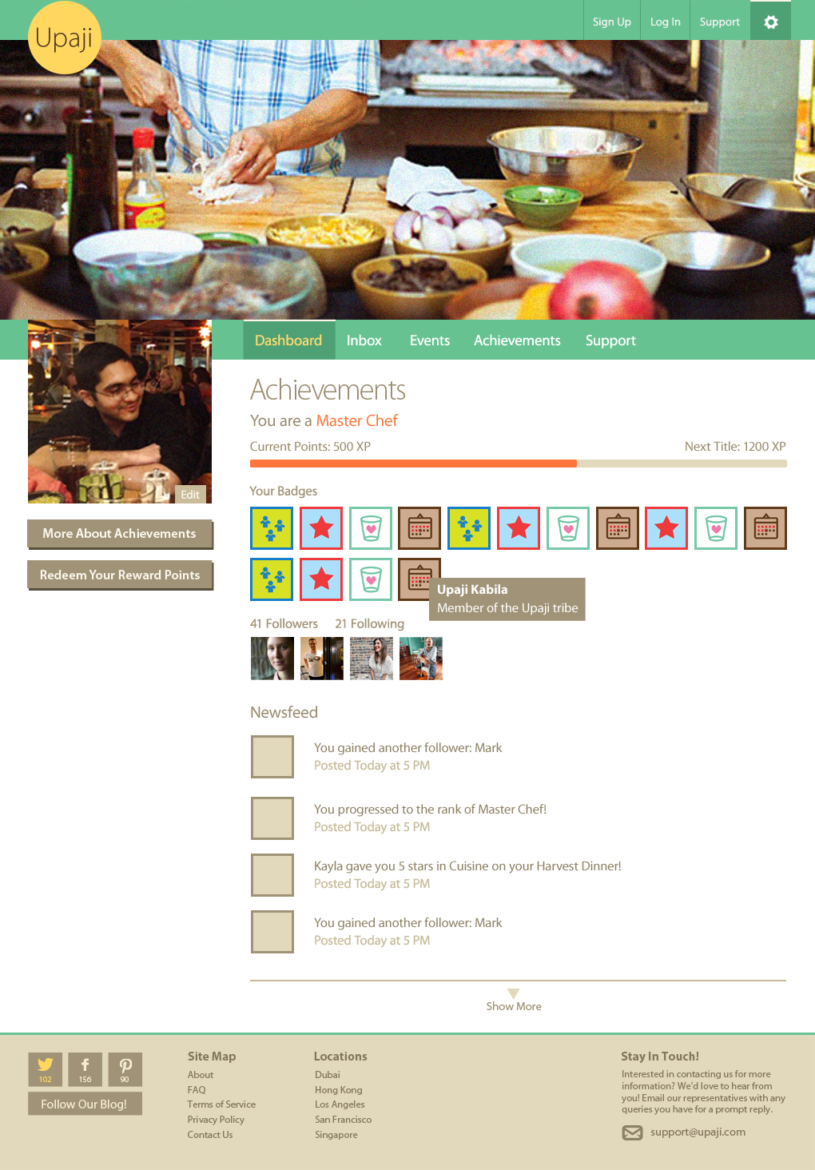

Slide 36
If the User clicks on the Support tab from the sub navigation bar of the Dashboard, they will be taken to their Upaji Support section.

Slide 37
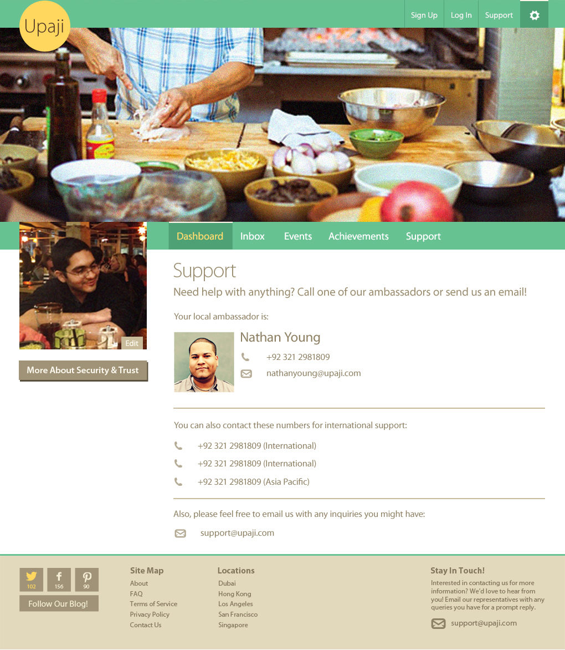

Slide 38
Upon clicking on create an event page from dashboard or Host an Event button on Homepage, users will be taken to the following page from where they can create their event.

Slide 39
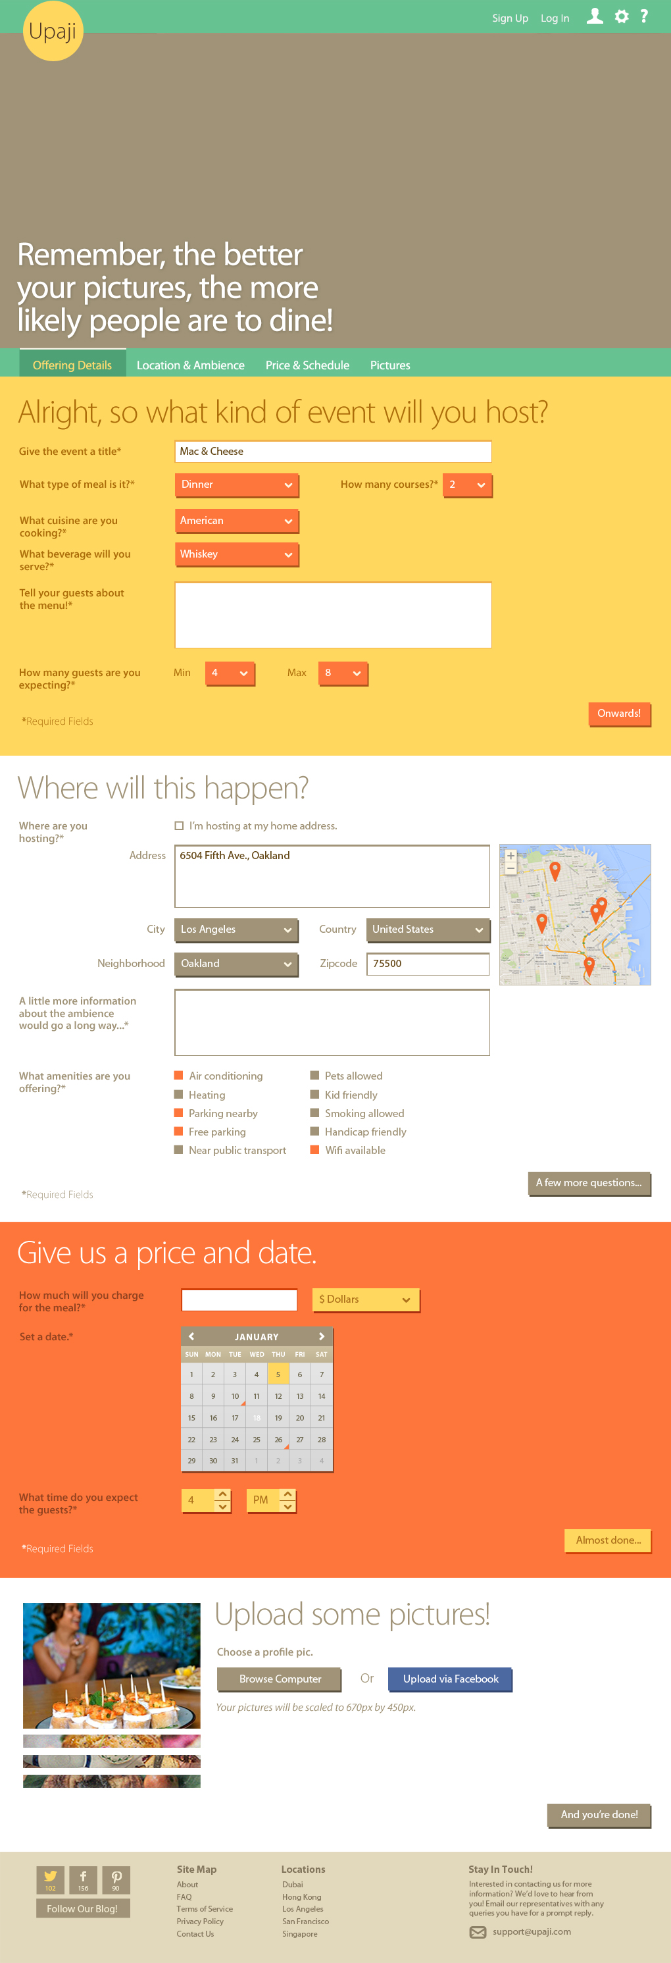

Slide 40
Once the users have attended an event, they will be sent an email from Upaji to provide feedback on the event. The email will have a link to the page from where users can review and rate their event experience.

Slide 41
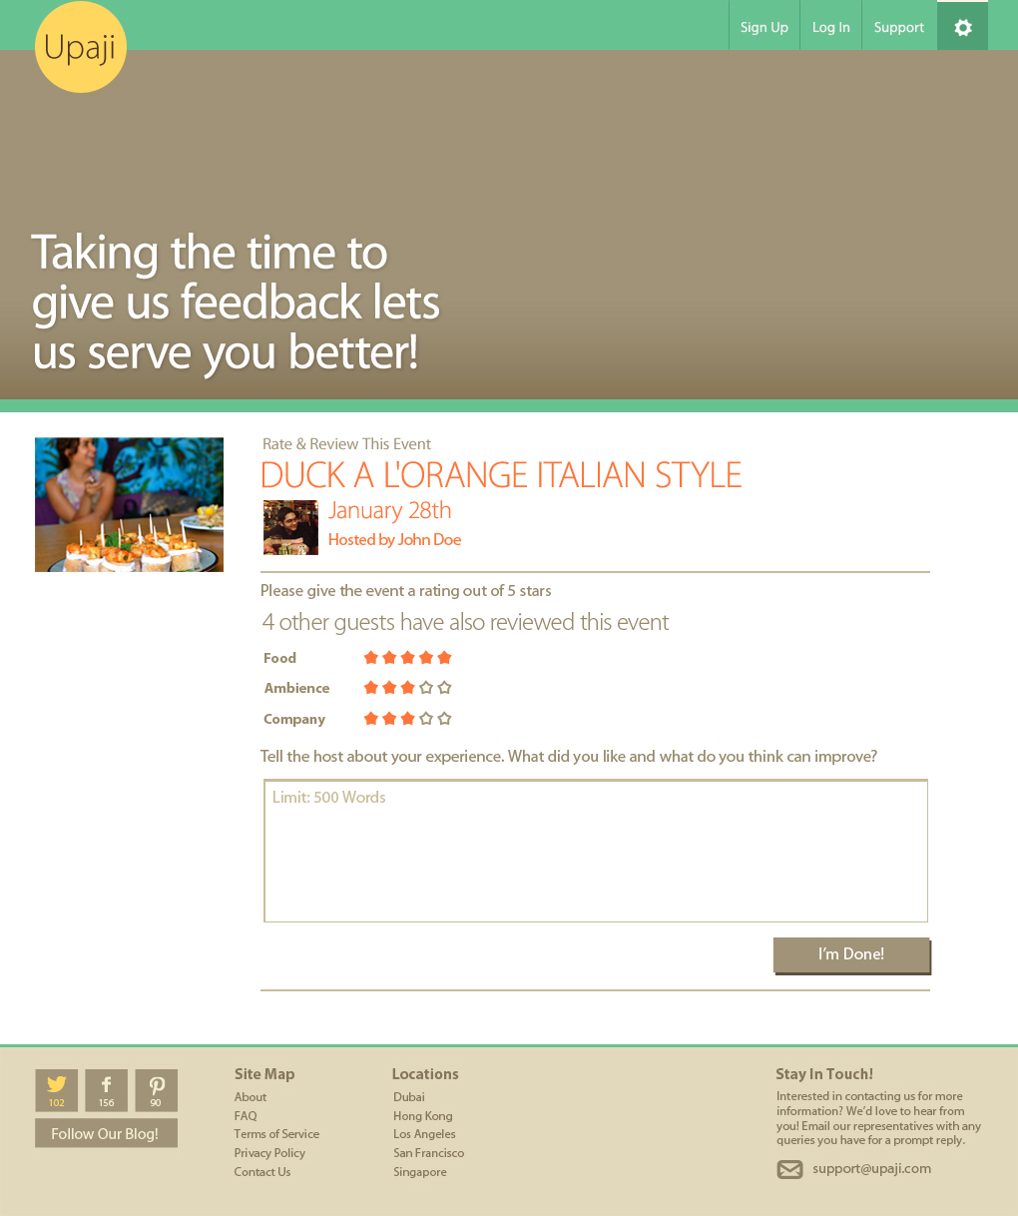

Slide 42
Thank you ! --------------------- -- End --

